Slide 1
text-to-phoneme
John Ramberger
Georgia Institute of Technology

Slide 2
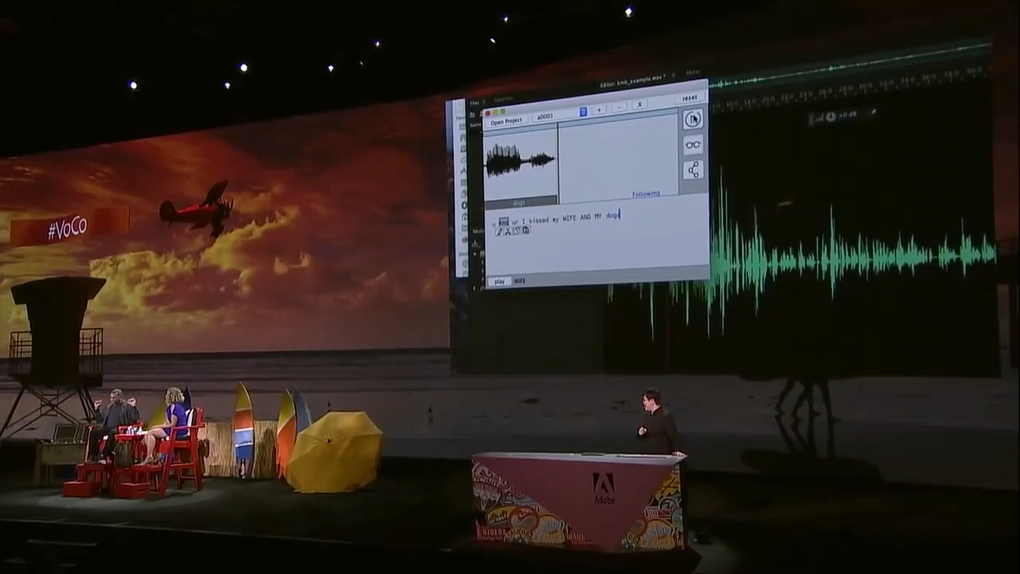
Inspiration

Slide 3
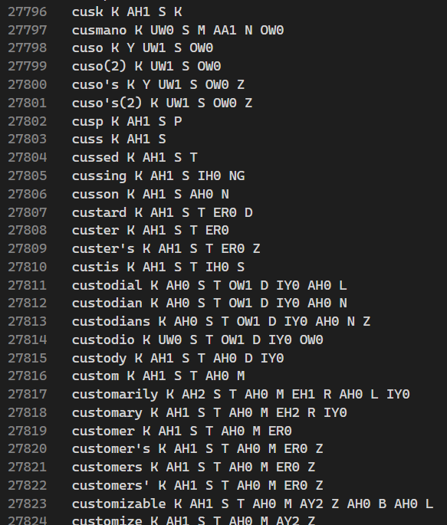
Inspiration pt. 2 - CMU Pronouncing Dictionary
Dictionary of all words and their pronunciation.

Slide 4
My Goals for this Project
To make something similar to Adobe VoCo.
The program can output at least one decent sounding sentence.

Slide 5
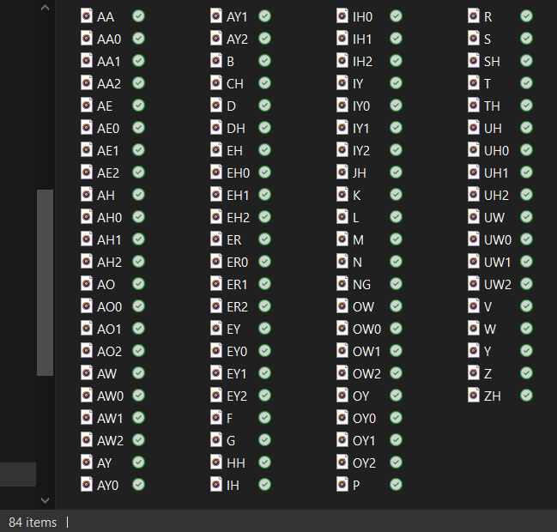
Design
Simplest method possible
Use sound clips to piece together words
Steps:
Convert user input to pronunciation using dictionary
Find and merge all audio clips to create words
Combine words with spaces in between to form sentences
Normalize audio output
Framework
Node.js

Slide 6
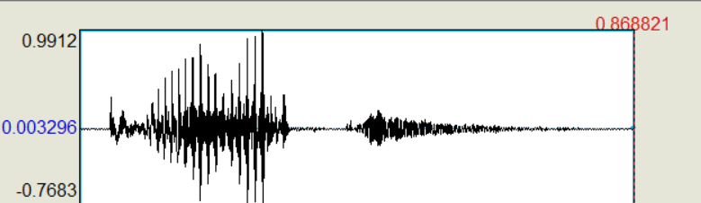
What did I learn while working on this project?
Working with audio is a very difficult task
especially when you are working with over 80(!) different audio files.
Sound Inflection matters
We use different sounds when using the same letters in different settings, but with the CMU Pronouncing Dictionary, there is only one pronunciation for some sounds. Lost vs beLL
Word spacing matters
The whitespace in words is important, and without it, the words sound different or weird
The word ‘plots’ recorded

Slide 7
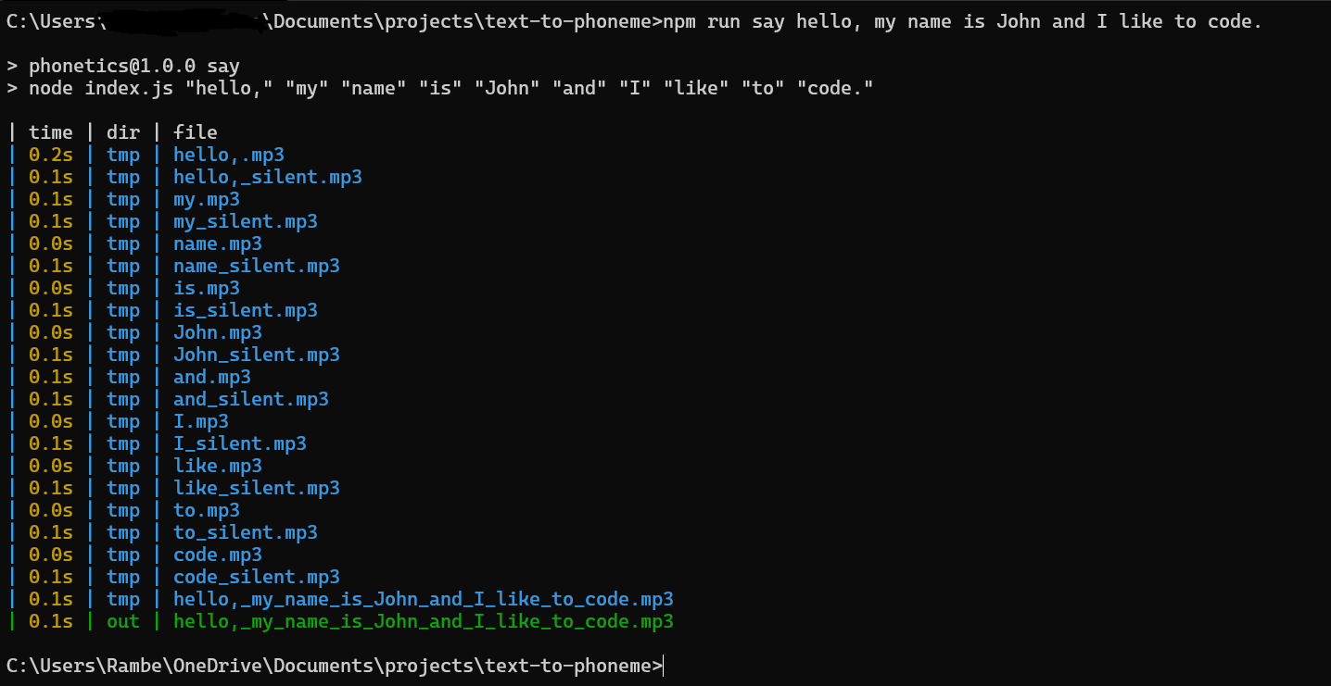
Final Product
Only 1 command

Slide 8
How it works
Run the say command with whatever you want the program to say
Ex: npm run say hello
The program then outputs the audio file and that’s it!
Yes, it’s a small program

Slide 9

Live Demonstration

Slide 10

Questions

